Slide 1

Group 3: Project Fitness and Health Tracker Analysis

Slide 2
Group Members:
• Olabode Durosinmi
• Georgina Joe .O
• George Okafor
• Chinedu Abuaja

Slide 3
Project Scope
Fitness and Health Tracker Analysis 🎯 Comprehensive Objective: This project focuses on analyzing personal health and fitness tracking data to uncover trends in physical activity, hydration, sleep, and calorie expenditure across different age groups and genders. Students will utilize SQL to extract key insights, Excel for aggregation and comparative analysis, and Power BI to create dynamic dashboards that visualize wellness patterns. They will explore the relationship between lifestyle habits and fitness metrics, identify which exercise types yield the highest calorie burn, and assess whether people meet recommended health standards. By integrating data from a questionnaire, students can also personalize insights and offer practical wellness suggestions based on empirical evidence. Tools:
● Excel: Calculate weekly calorie burn averages
● SQL: Filter records by age groups, exercise types
● Power BI: Visualize steps, sleep, and hydration trends
Tasks:
● Discover trends in daily activity levels across age groups
● Evaluate the relationship between sleep and calories burned
● Build a Power BI health dashboard with filters for gender & exercise type
Questionnaire Ideas:
● Do you regularly track your steps?
● What’s your most common workout activity?

Slide 4
Fitness & Health Tracker Analysis
Comprehensive insights on activity, sleep, hydration, and calories across age and gender groups.

Slide 5
Links to All Files for this Project
Powe Bi Dashboard
Excel File
SQL Query File

Slide 6
1. Trends in Daily Activity Across Age Groups
Older age groups (41–60) recorded higher daily step counts.
01
Users aged 51–60 were the most active overall.
02
Cardio and Yoga were popular among ages 30–50.
03
Younger users (18–30) had more irregular activity patterns.
04

Slide 7
2. Sleep vs Calorie Burn
Weak positive correlation (≈ 0.14) between sleep hours and calories burned.
• More sleep slightly correlates with higher calorie burn.
• Exercise type and intensity influence calorie burn more significantly.

Slide 8

3. Hydration Insights
Average daily intake: 1.5–2.0 liters.
• Below recommended: 2.7L (women), 3.7L (men).
• Hydration habits need improvement across all groups.

Slide 9

4. Weekly Calorie Burn Trends
Highest calorie burn on Mondays (~492 kcal).
• Lowest calorie burn on Fridays (~450 kcal).
• Activity declines toward the weekend.

Slide 10
5. Power BI Dashboard Highlights
Interactive filters: Gender, Age Group, Exercise Type, Day of Week.
Cardio produces the highest calorie burn per session.
Sleep is relatively consistent: 6.5–7.5 hours average.

Slide 11
6. Key Takeaways & Recommendations
Encourage younger users to build consistent habits.
Promote cardio for effective calorie burning.
Most users fall short on hydration and recommended sleep.
Leverage Monday motivation for fitness push.

Slide 12
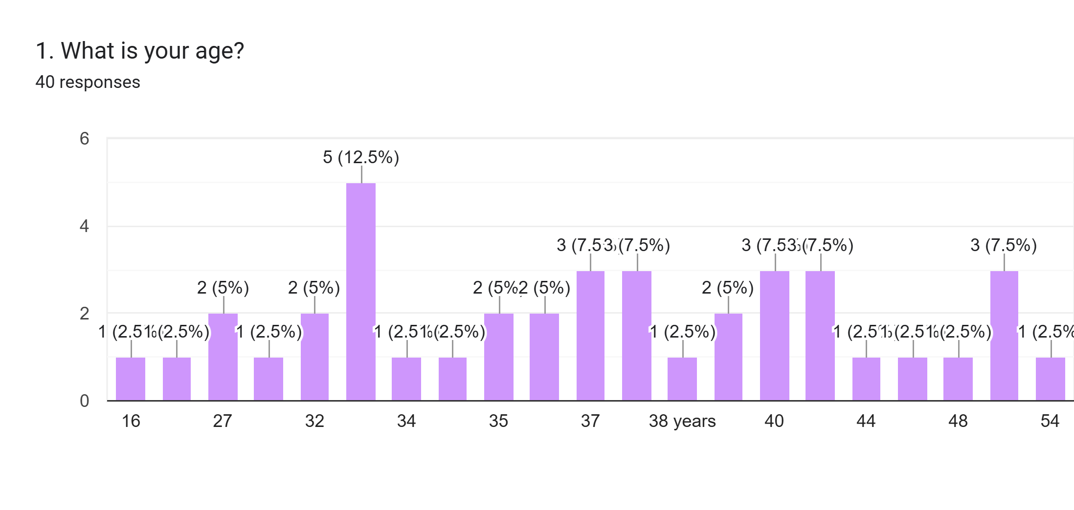

Slide 13
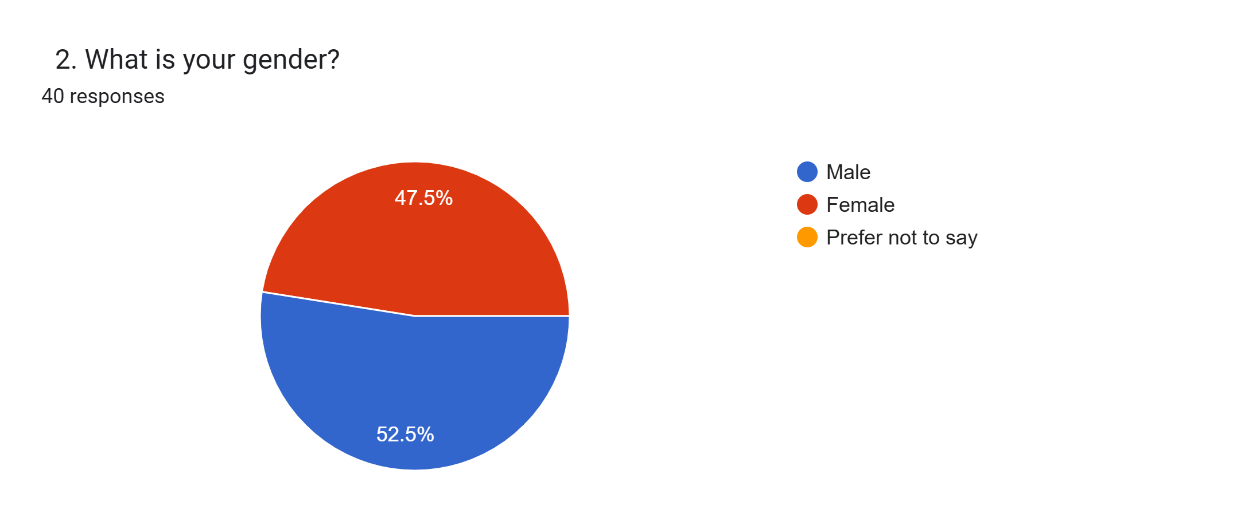

Slide 14
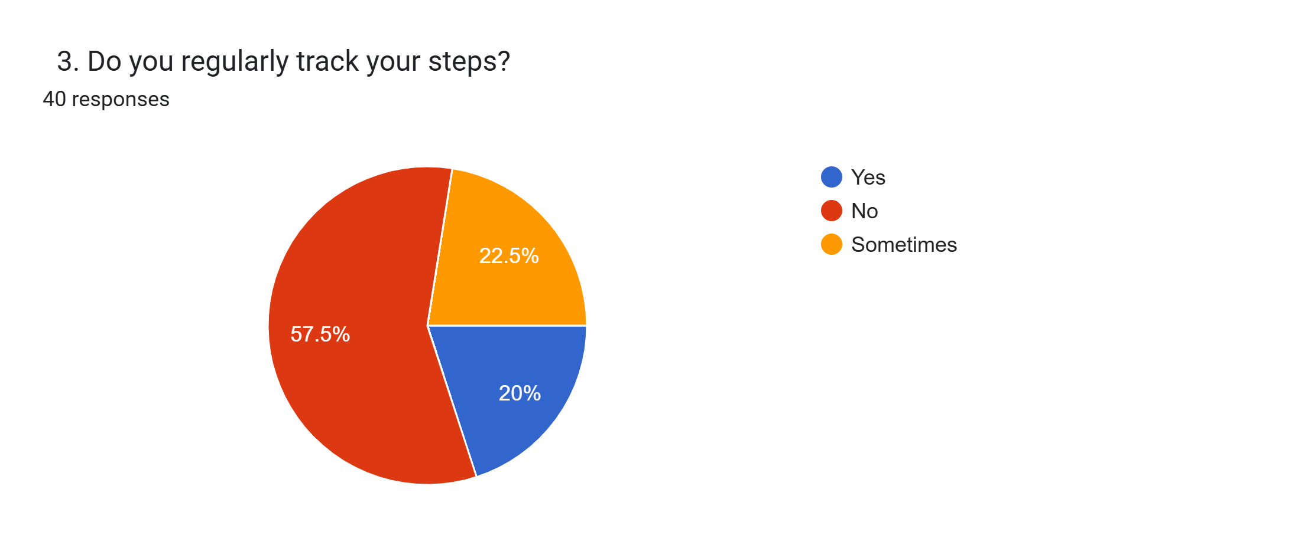

Slide 15
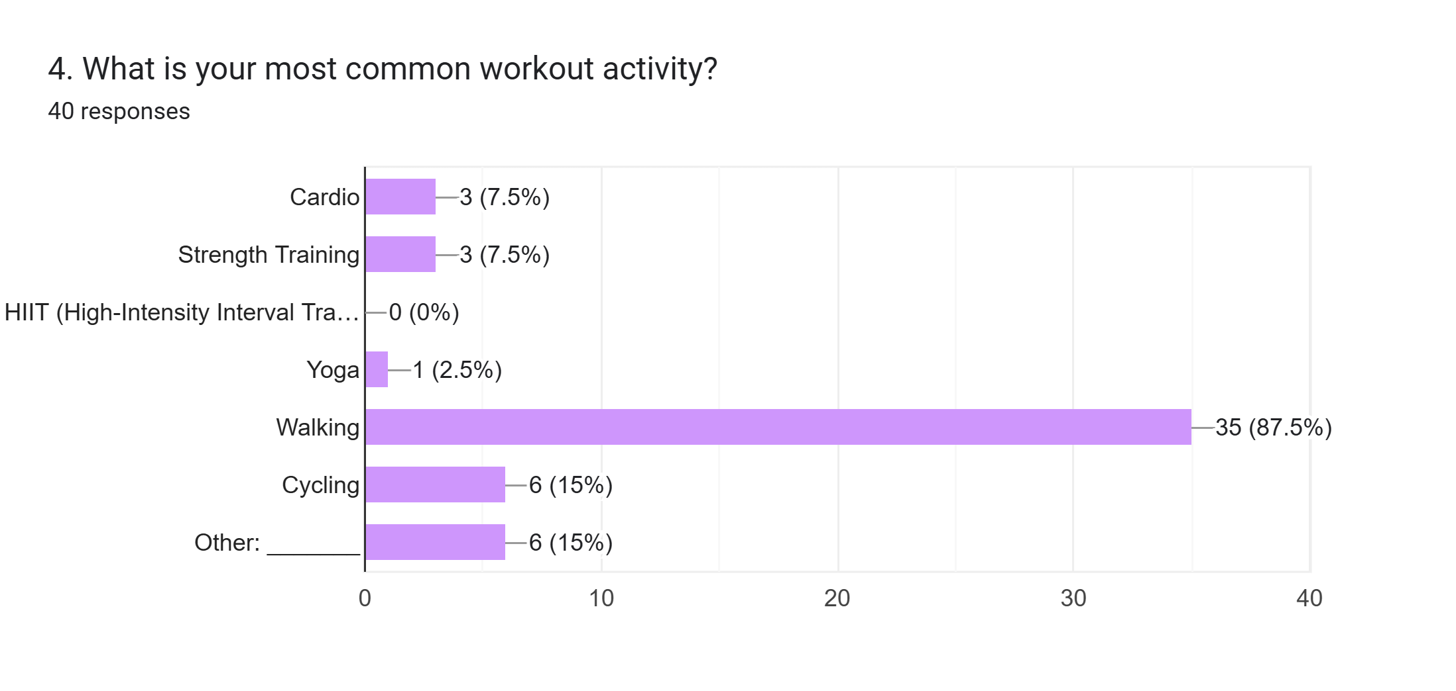

Slide 16
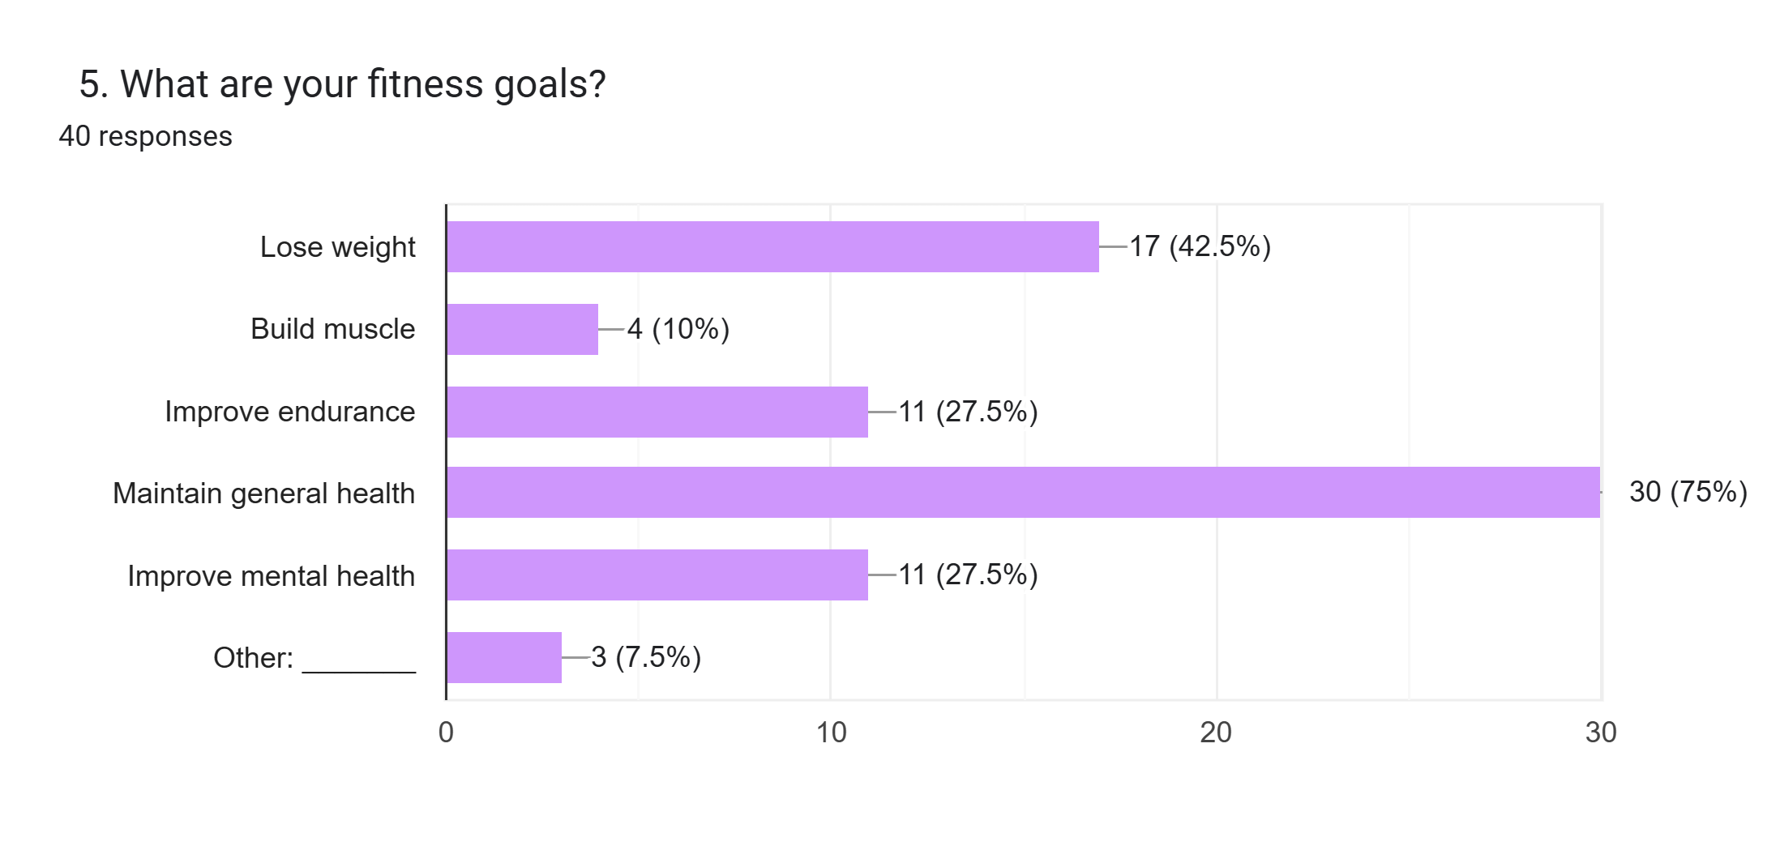

Slide 17
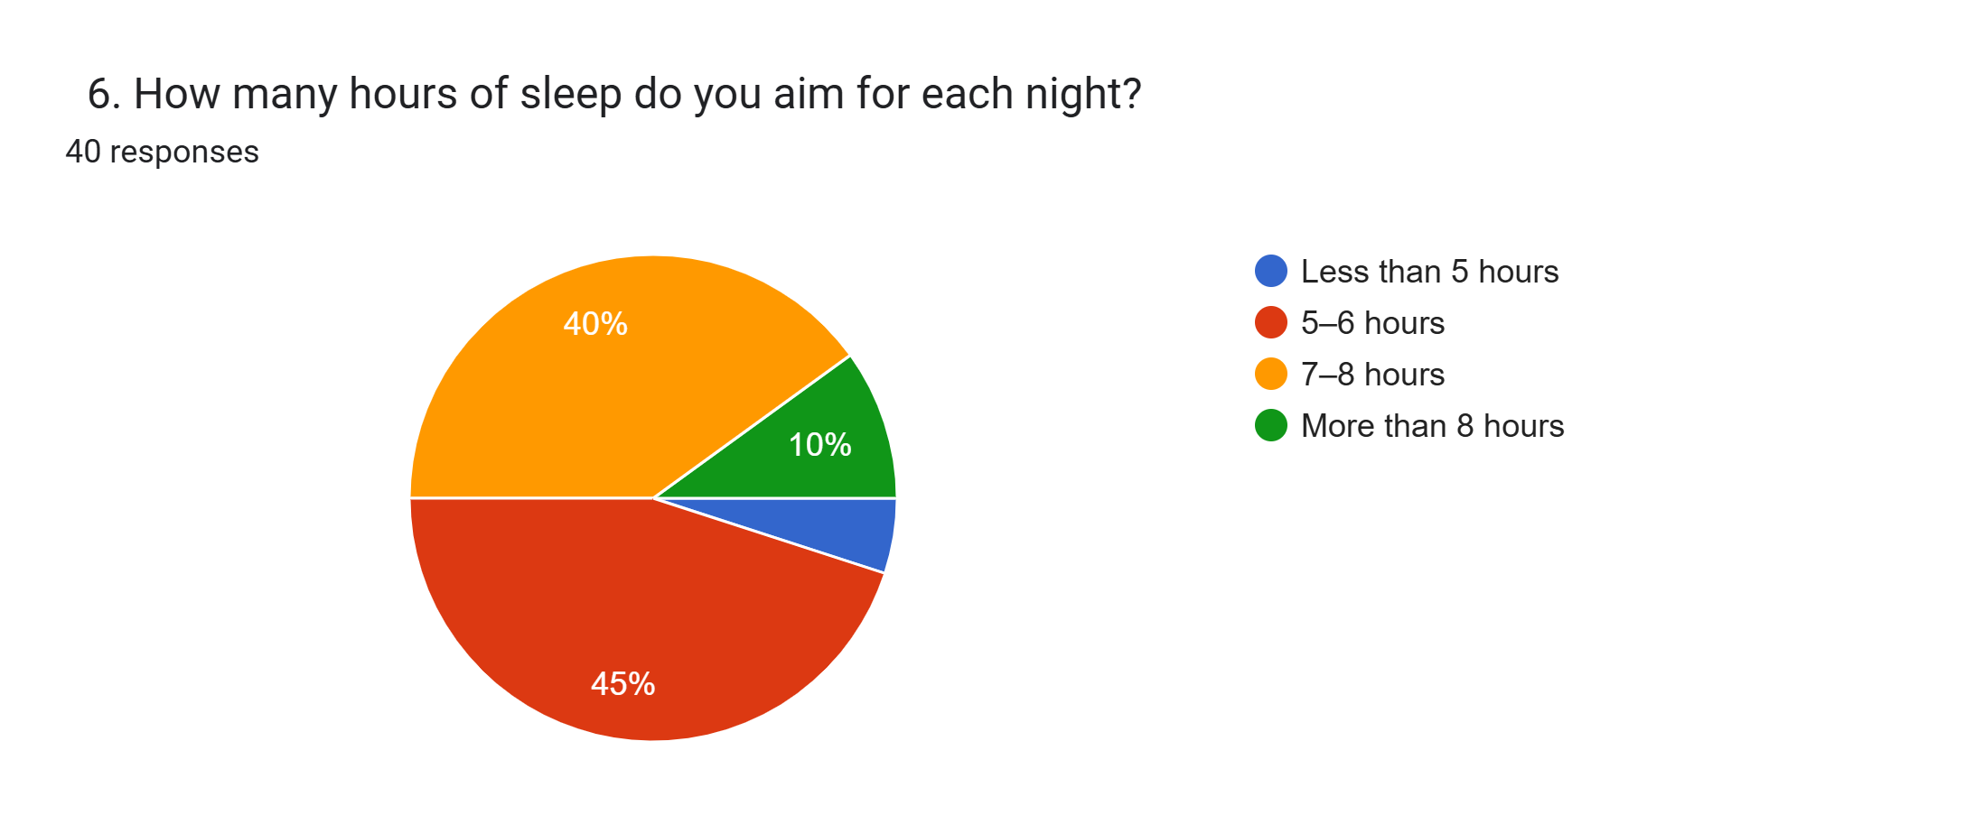

Slide 18
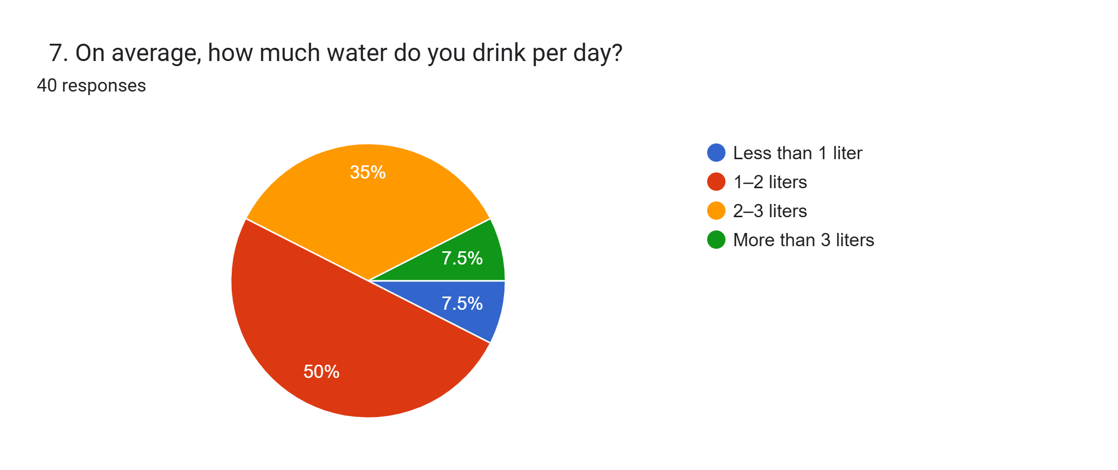

Slide 19
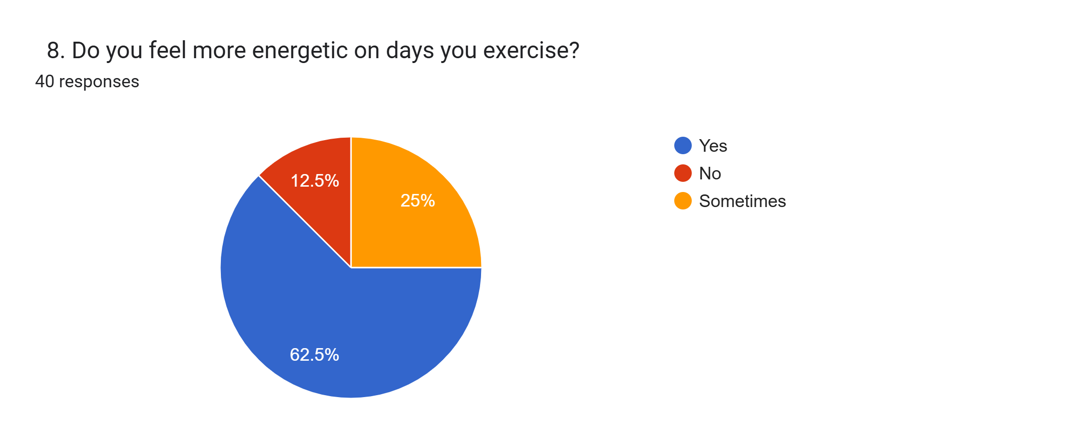

Slide 20

9. Do you have any health conditions that affect your ability to exercise?
13 responses
No
None
N/A
No
No really, sometimes usually have waist pain when I walk for a long time
Stomach ulcer
NIL
Nope

Slide 21
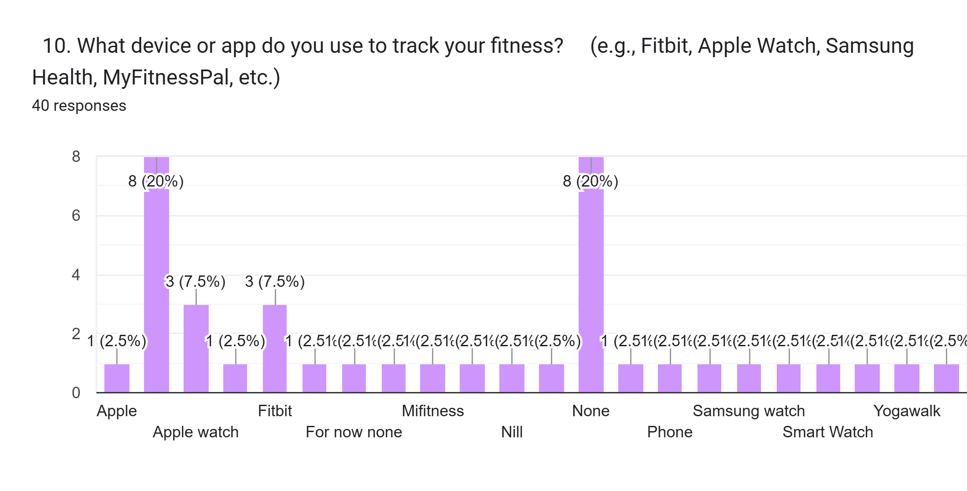

Slide 22
🧍‍♂️ 1. User Behavior & Tracking Habits
Survey Insight: Many respondents do not regularly track steps or use fitness trackers.
Data Alignment: This explains why some users in your dataset have missing or zero values for Steps_Taken or Exercise_Type.
💪 2. Common Workout Activities
Survey Insight: The most frequent activities were walking, cardio, and home workouts.
Data Support: Cardio is the most common activity in the tracker dataset and has the highest average calorie burn, validating that cardio is both popular and effective.
🧠 3. Motivators for Exercise
Survey Insight: Motivation drivers include staying fit, mental health, and body goals.
Implication: Tailored recommendations in your dashboard could address these motivators by linking exercise types to specific goals (e.g., mental wellness = yoga, fat burn = cardio).
💦 4. Hydration Habits
Survey Insight: Responses suggest occasional hydration awareness but not consistent tracking.
Data Support: Tracker data confirms suboptimal intake — users typically drink less than recommended levels, suggesting education or alerts may help.
🛏 5. Sleep Quality
Survey Insight: Many mentioned inconsistent sleep or stress-related issues.
Data Support: Sleep hours vary significantly (from <5 to >8), and low correlation with calorie burn implies quality (not just quantity) might be the real issue.
🚑 6. Health Conditions
Survey Insight: A few users reported waist pain, ulcers, or general fatigue, which may affect activity choices.
Recommendation: Include gentle alternatives like stretching, yoga, or water-based workouts in your wellness suggestions.
7. Survey-Based Insights Integrated with Dataset

